Slide 1
Histogram Processing
Image Processing

Slide 2
Tutorial
Image histograms
Histogram equalization and spesification
Other histogram modification techniques

Slide 3
Image Histograms
Goal
The goal of this tutorial is to use MATLAB and IPT to calculate and display image histograms.
Objectives
Learn how to use the IPT function imhist.
Learn how other MATLAB plotting techniques can be used to view and analyze histogram data.

Slide 4

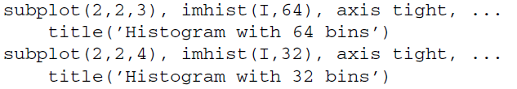
Image Histograms: imhist
1. Display an image and its histogram.
2. The previous step displayed the default histogram for the image—a histogram with 256 bins. Let us see what happens if we change this value to 64 and 32.
You may have noticed that we set the axis to tight when displaying histograms.
This adjusts the axis limits to the range of the data.

Slide 5
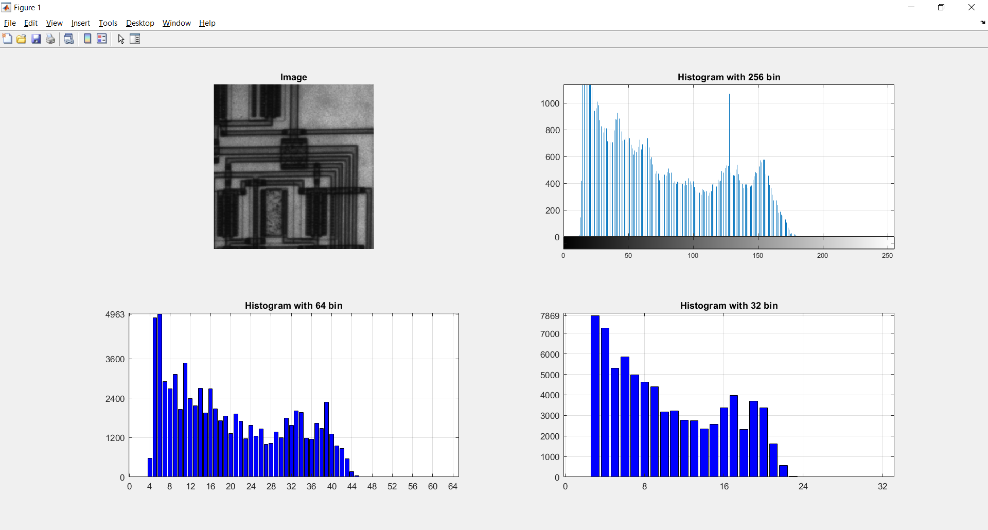
Image Histograms: imhist
Question 1
Explain the drastic change of the Y-axis values when the histogram is displayed with fewer bins.

Slide 6

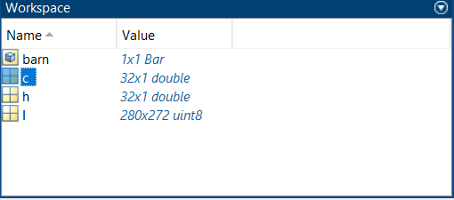
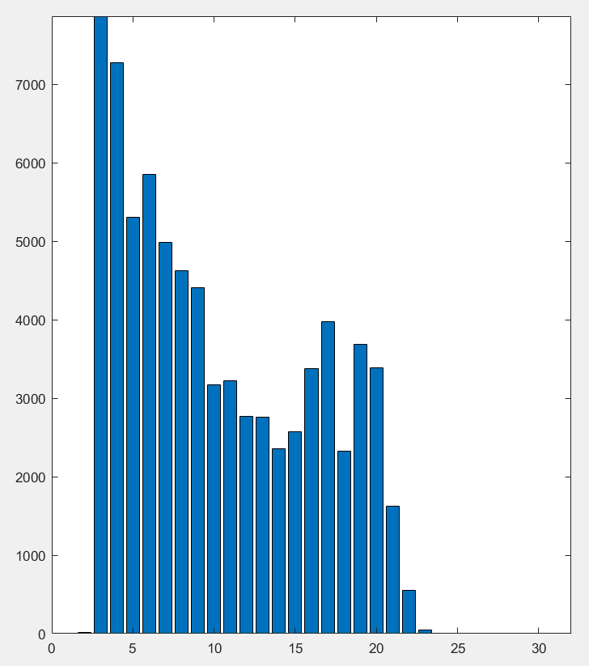
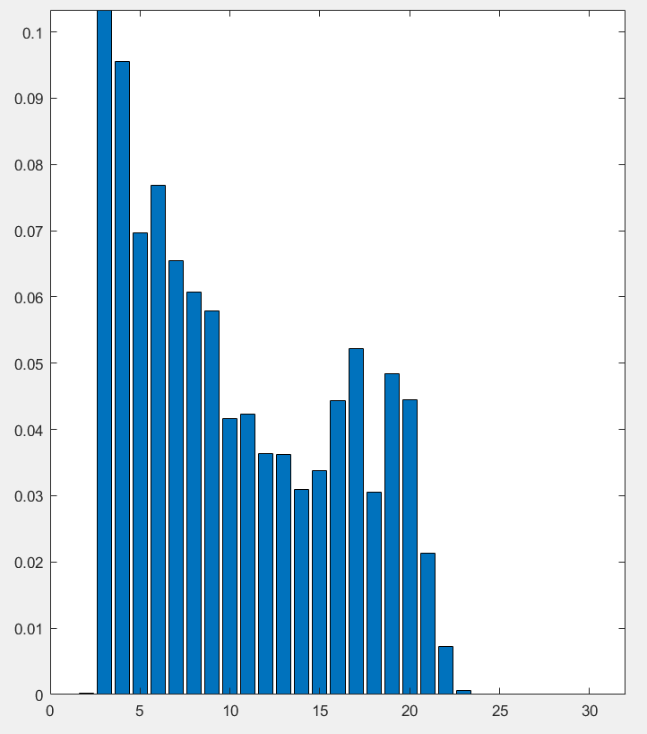


Image Histograms: bar
3. Get the values of each bin in the histogram for later use.
We can now use the values in c to display histogram using other plotting techniques.
Naturally, the plot of a histogram displays the count of each bin, but it may be more relevant to plot each bin’s percentage.
This can be done by normalizing the data
4. Normalize the values in c.
Question 2
What does the function numel do?
Question 3
Write a one line MATLAB statement that will verify that the sum of the normalized values add to 1.

Slide 7
Image Histograms: bar
In MATLAB, almost every object you create can be customized.
When we create the bar chart, there is an axes object and a bar chart object displayed on the axes object.
Here, the variable bar_1 is set to the bar chart object so that we can reference it later for further customization.
The set function allows us to change settings of a particular object.
The first parameter of the set function is the object you wish to customize. In this case, the first object we customize is gca, which stands for get current axes.
Here, we set the limits of the X and Y axes. Even though the limits have been set, the graph is still ambiguous because the tick marks on the X and Y axes do not reflect the limits.

Slide 8
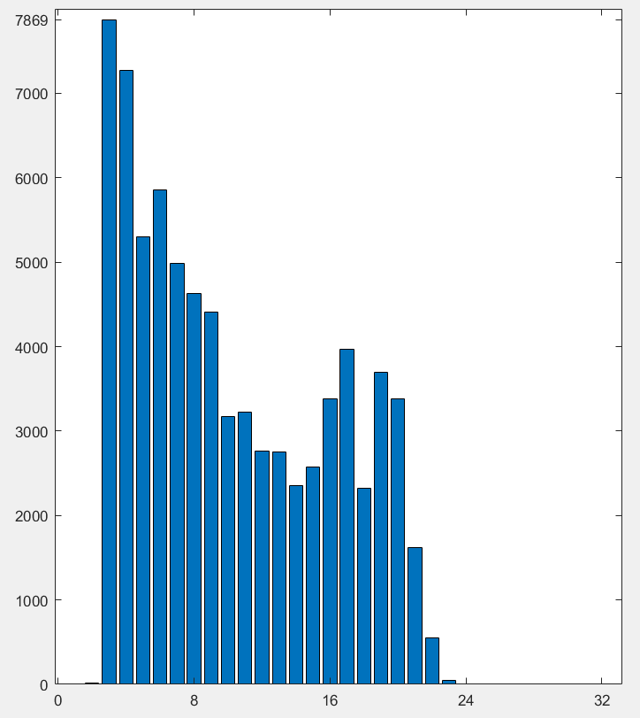

Image Histograms: The Ambiguity
VS

Slide 9
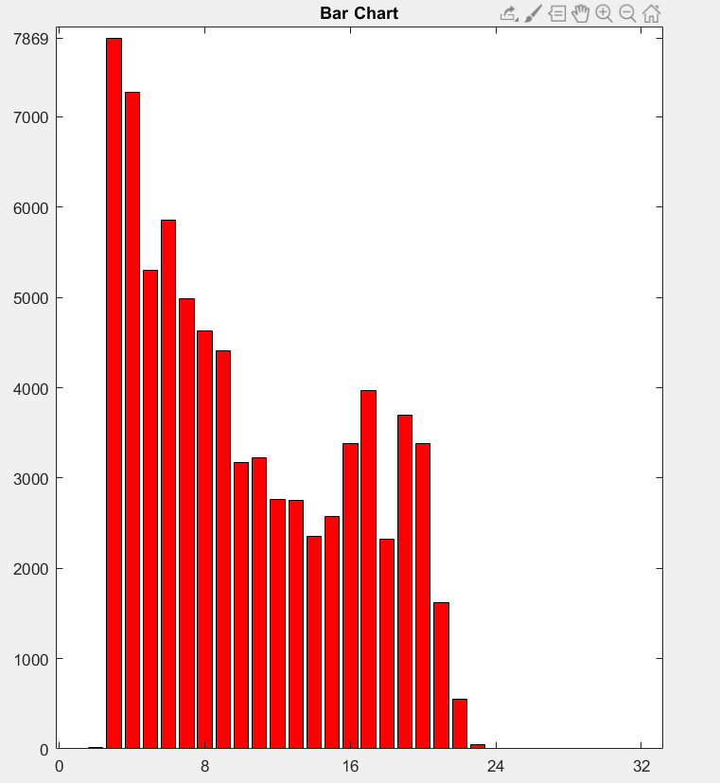

Image Histograms: Customize Graph Object
5. Set the tick marks to reflect the limits of the graph.
6. Use the set function to change the color of the bar chart. Also, give the charta title.
Question 4
How would we change the width of the bars in a bar chart?
Notice in the previous step how we used the bar chart object bar_1 when changing settings.
Similarly, we can display the normalized bar chart on the same figure using subplot.

Slide 10
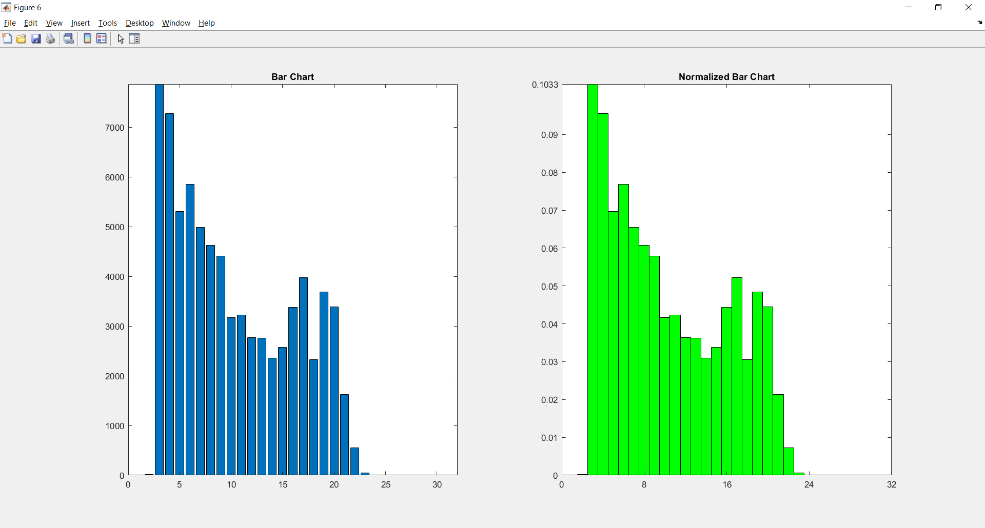
Image Histograms: Customize Graph Object

Slide 11
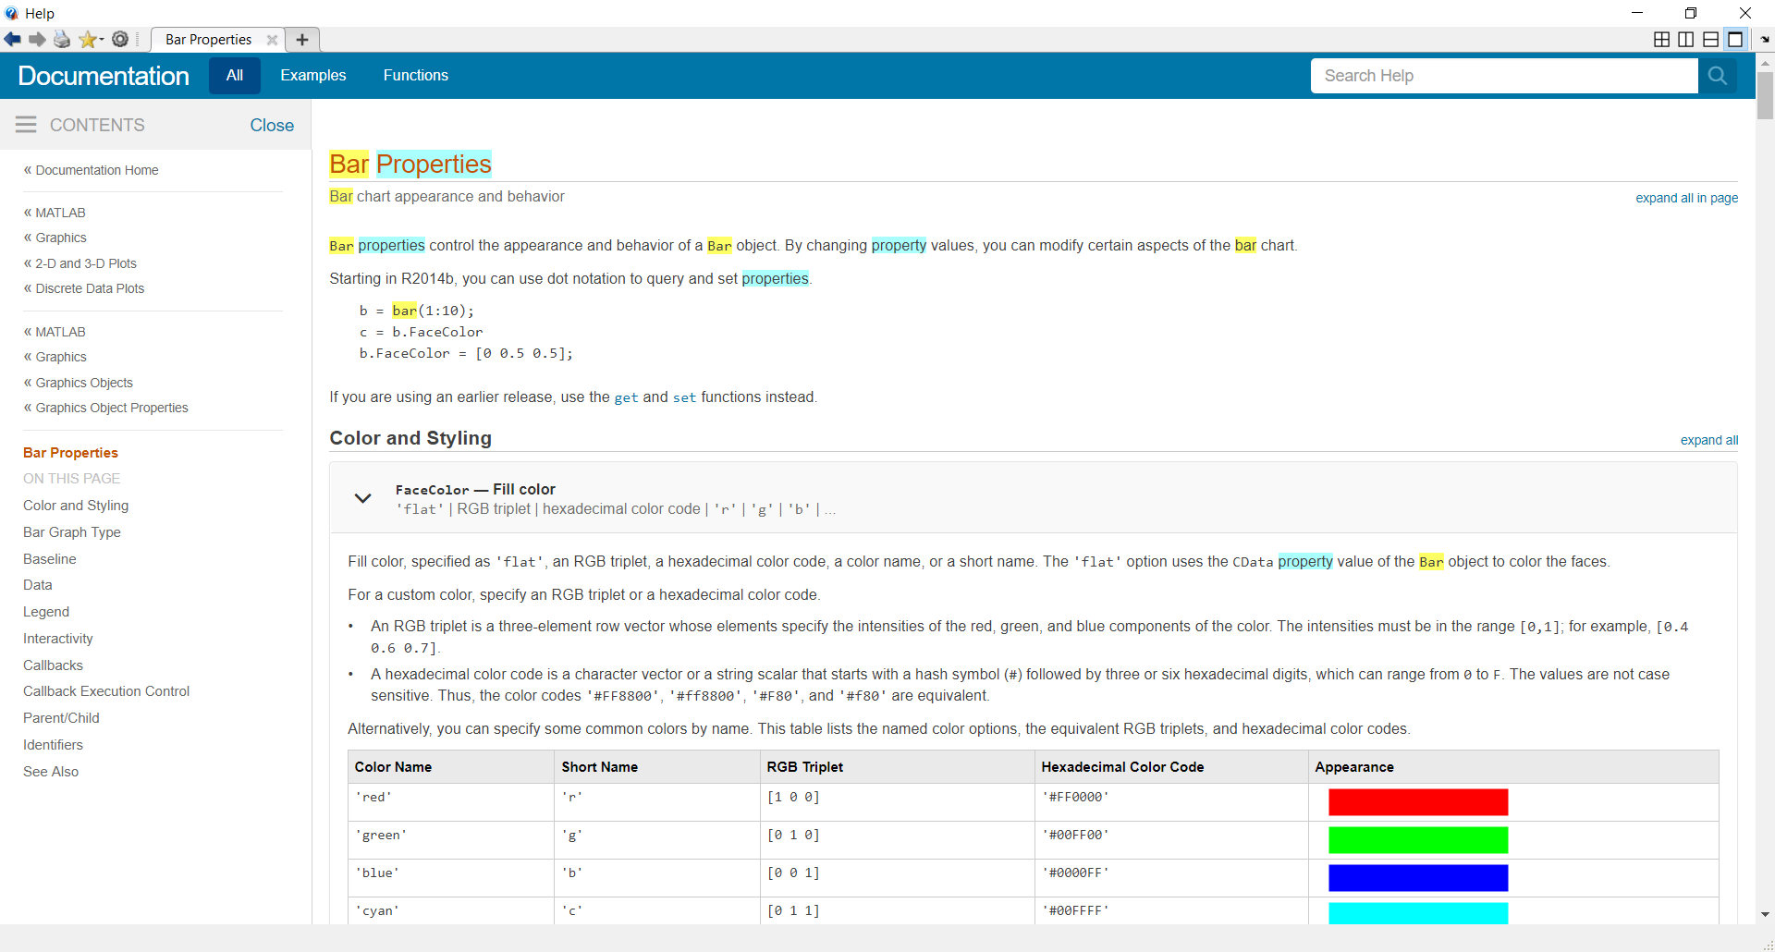
Image Histograms: Customize Graph Object

Slide 12
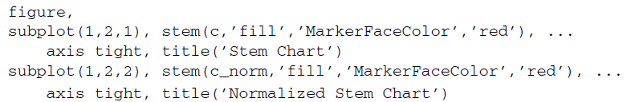
Image Histograms: stem
You may have noticed that we used xlim and ylim functions to set the limits of the axes.
Sometimes there is more than one way to accomplish the same task, and this is an example of just that.
Stem charts are similar to bar charts.

Slide 13
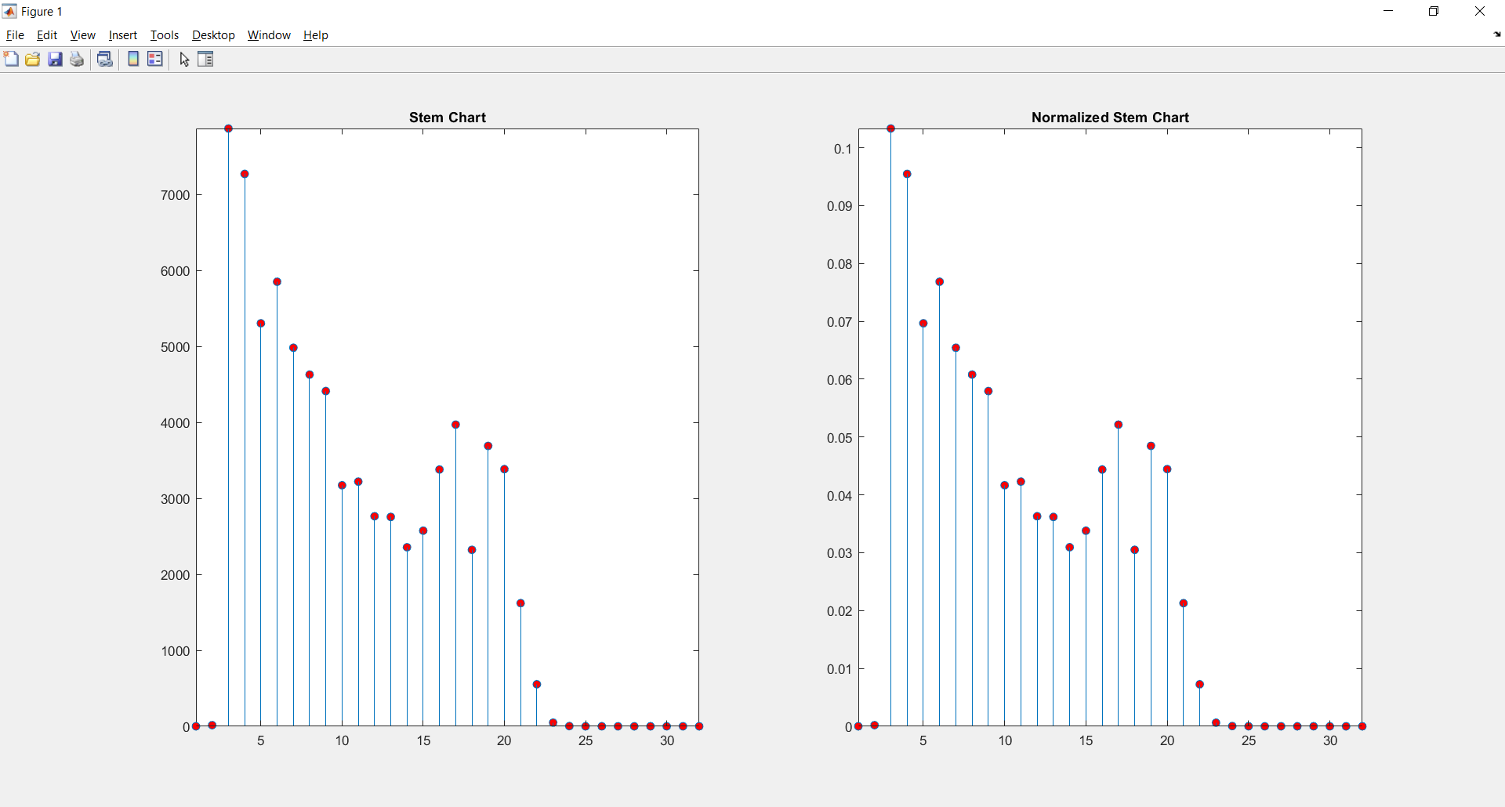
Image Histograms: stem
Question 5
Explore the properties of stem charts. How can we make the lines dotted instead of solid?
Question 6
Alter the axes limits and tick marks to reflect the data being displayed in the stem plot.
We could have just as easily set a variable equal to the stem plot object and used the
set function to make the changes.

Slide 14

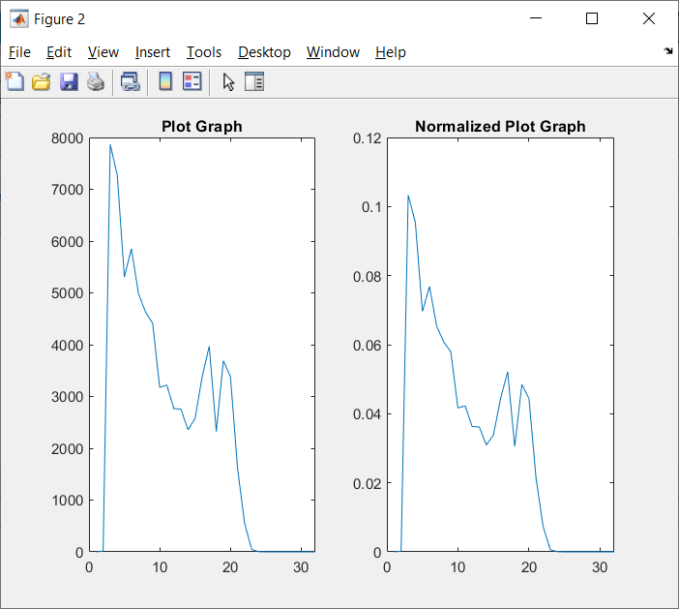
Image Histograms: plot
7. Display a plot graph for both standard and normalized histogram data.
The plot function will display the data by connecting each point with a straight line.
Question 7
Explore the properties of plot graphs. In the above code, the points for each bin are visually lost within the graph line.
How can we make the points bolder so that they are more visible?

Slide 15
Histogram Equalization and Spesification
Goal
The goal of this tutorial is to learn how to use the IPT for (global and local) histogram equalization and histogram specification (matching).
Objectives
Explore the process of histogram equalization.
Learn how to use the histeq function.
Learn how to perform histogram specification (matching).
Explore the Interactive Histogram Matching demo.
Learn how to perform local histogram equalization with the adapthisteq function.
What You Will Need
ihmdemo.m—interactive Histogram Matching demo M-file

Slide 16
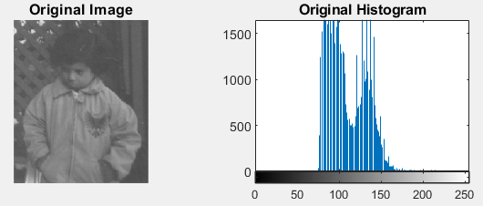
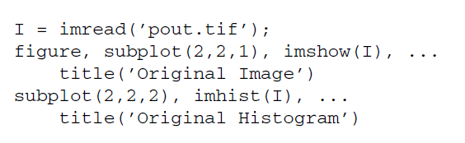
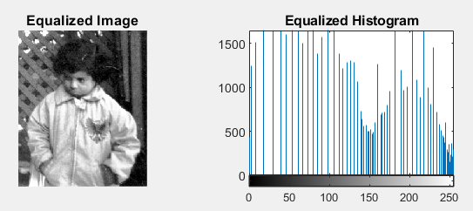

Histogram Equalization
1. Display the image pout and its histogram.
2. Use the histeq function to perform histogram equalization.
Question 1
Why must we include the second parameter (256) in the histeq function call?
Question 2
What is the effect of histogram equalization on images with low contrast?

Slide 17
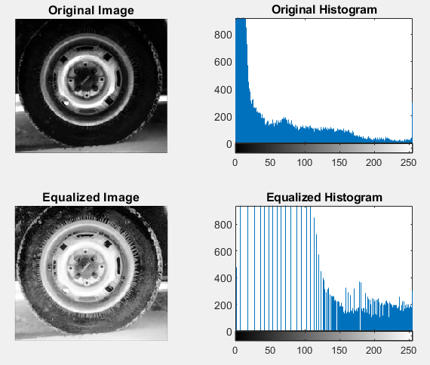
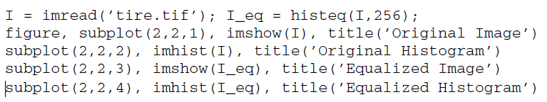
Histogram Equalization
4. Execute the following code to perform histogram equalization on the tire image.
Question 3
Based on the tire image’s original histogram, what can be said about its overall brightness?
Question 4
How did histogram equalization affect the overall image brightness in this case?

Slide 18
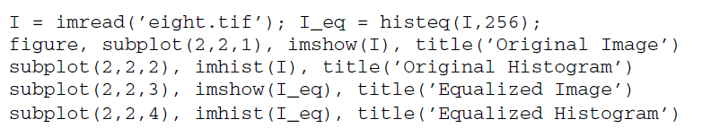
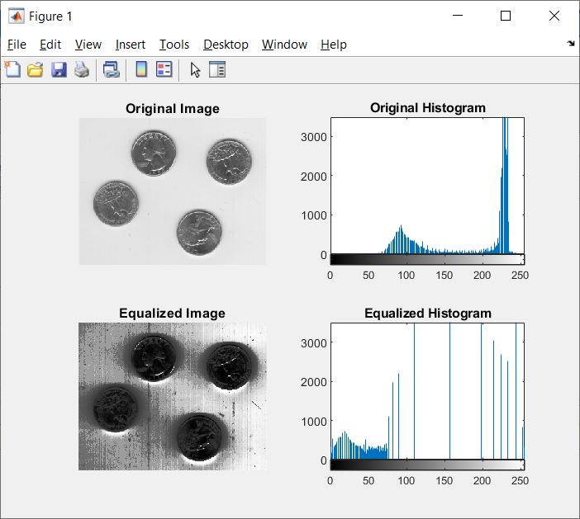
Histogram Equalization
Histogram equalization does not always perform well. As we will see in the next steps, it depends on the original image.
Question 5
Why was there such a loss in image quality after histogram equalization?

Slide 19
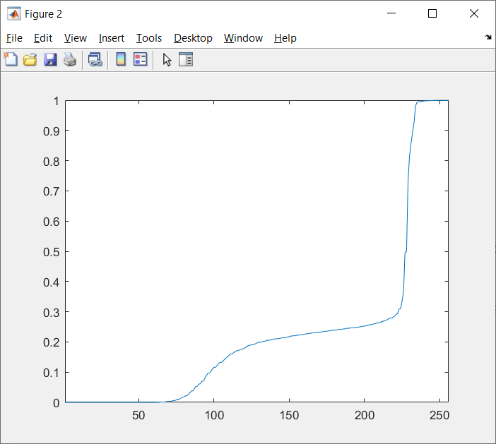
Histogram Equalization: CDF
The transformation function for histogram equalization is simply the cdf of the original image.
5. Display the normalized cdf for the eight.tif image.
Question 6
What does the cumsum function do in the previous step?

Slide 20

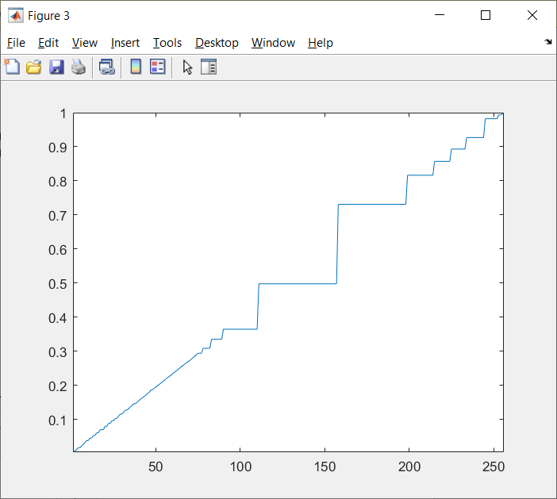
Histogram Equalization: CDF
6. The transformation function can also be obtained without using the cumsum function.

Slide 21

Histogram Spesification
As we have learned, the histogram equalization process attempts to flatten the image histogram.
Histogram specification (also known as histogram matching) tries to match the image histogram to a specified histogram.
The histeq function can also be used for this operation.
7. Prepare a subplot and display original image and its histogram.

Slide 22
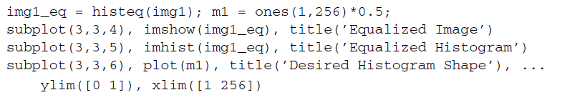
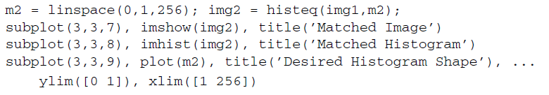
Histogram Spesification
8. Display the image after histogram equalization for comparison.
9. Display matched image where the desired histogram shape is a straight line from (0, 0) to (1, 1).

Slide 23
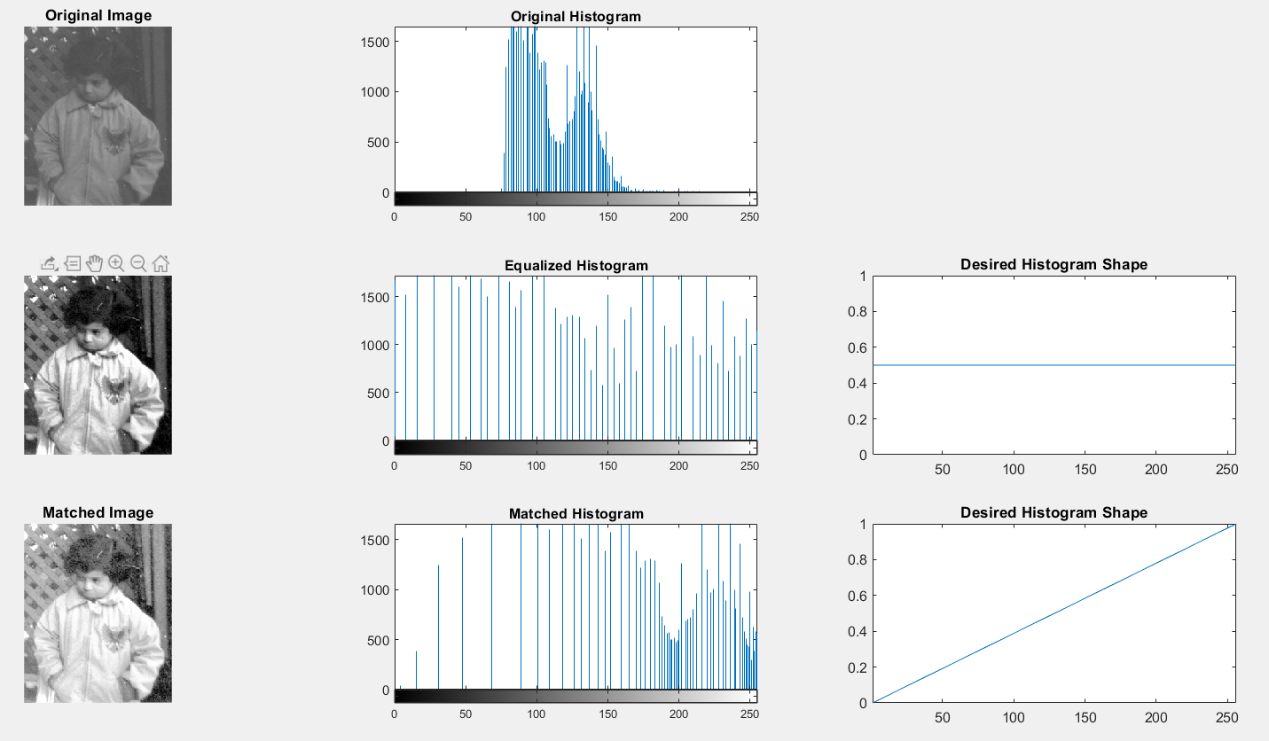
Histogram Spesification
As we can see from the previous steps, performing histogram specification means
we must generate a function that represents the shape of the desired histogram.

Slide 24
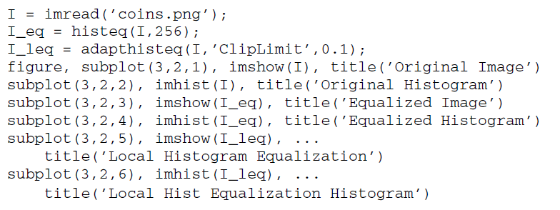
Local histogram equalization
Local histogram equalization is performed by the adapthisteq function.
This function performs contrast limited adaptive histogram equalization (CLAHE) and operates on small data regions (called tiles), whose size can be passed as a parameter.

Slide 25
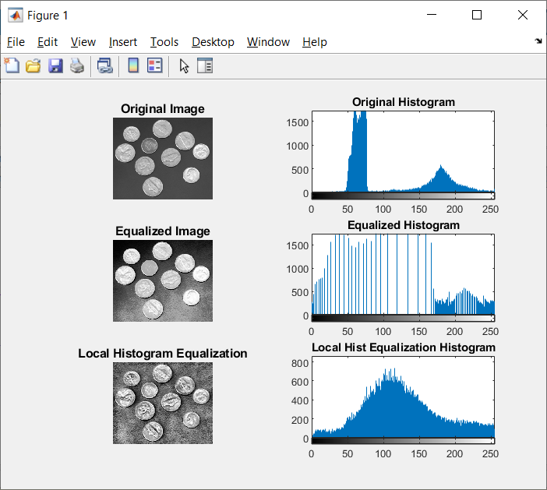
Contrast Limited Adaptive Histogram Equalization (CLAHE)
Question 10
What does the ClipLimit setting do in the adapthisteq function?
Question 11
What is the default tile size when using adapthisteq?

Slide 26
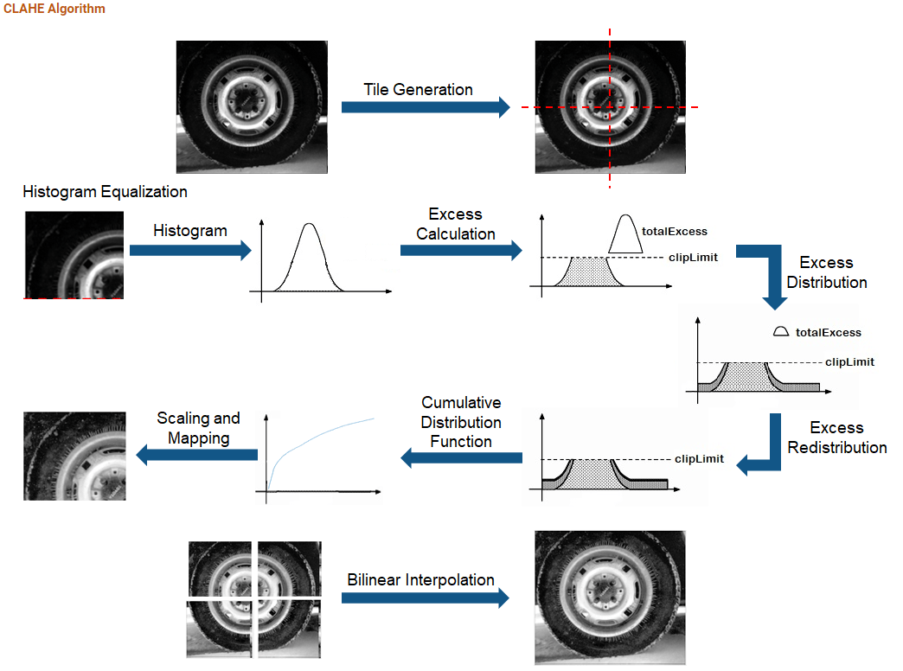
https://www.mathworks.com/help/visionhdl/ug/contrast-adaptive-histogram-equalization.html

Slide 27
OTHER HISTOGRAM MODIFICATION TECHNIQUES
Goal
The goal of this tutorial is to learn how to perform other common histogram modification
operations.
Objectives
Learn how to adjust brightness of an image by histogram sliding.
Learn how to use the imadjust function.
Learn how to use the stretchlim function.
Explore adjusting image contrast through histogram stretching (also known as input cropping).
Learn how to adjust image contrast with histogram shrinking (also known as output cropping).

Slide 28
Histogram Sliding
Histogram sliding is the process of adding or subtracting a constant brightness value to all pixels in the image.
When implementing histogram sliding, we must make sure that pixel values do not go outside the boundaries of the gray scale.
Therefore, any pixels that result in values greater than 1 after adjustment will be set to 1.
Likewise, any pixels resulting in values less than zero after adjustment will be set to 0.

Slide 29
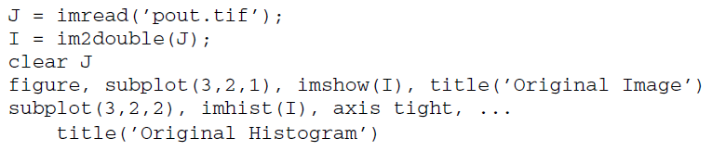
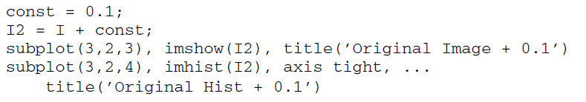
Histogram Sliding
1. Display original image and prepare subplot.
2. Obtain a brighter version of the input image by adding 0.1 to each pixel.
Question 1
How did the histogram change after the adjustment?

Slide 30
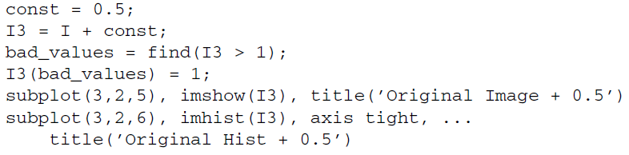
Histogram Sliding
3. Produce another brighter image by adding 0.5 to original image.
Question 2
What does the variable bad_values contain?
Question 3
Why does the third plot show such an excessive number of pixels with a value of 1?
“The brightness of an image can also be modified using the imadd function, which takes care of truncating and rounding off values outside the desired range in the output image.”

Slide 31
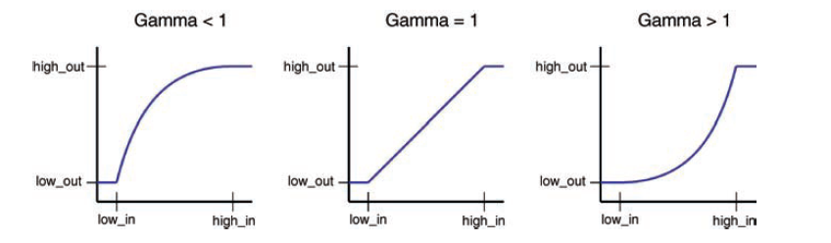
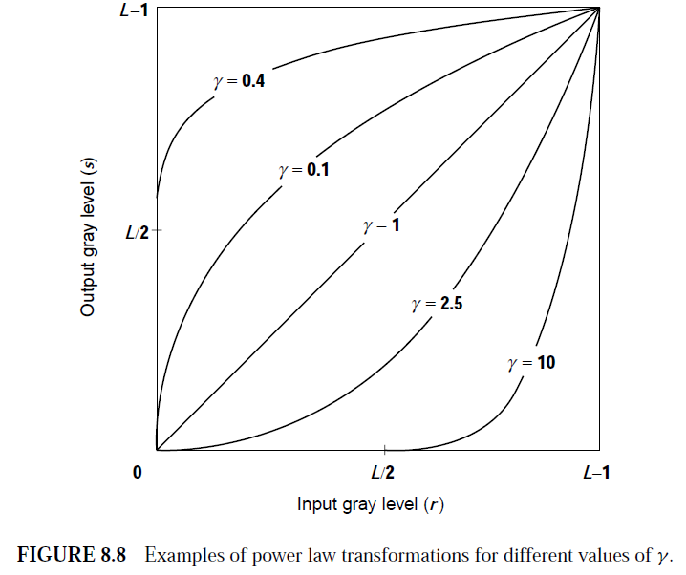

Histogram Streching
Histogram stretching and shrinking can be achieved through use of the imadjust function.
The syntax for the function is as follows:

Slide 32
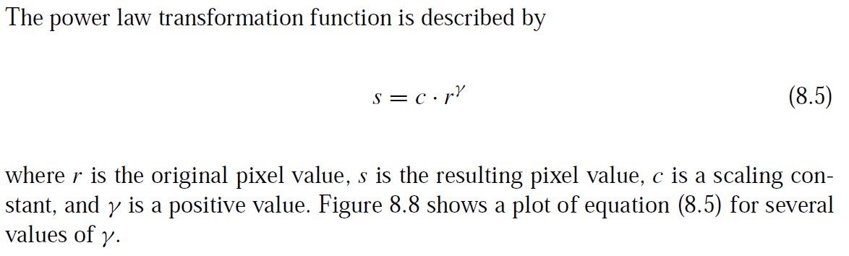
Power Law (Gamma) Transformations

Slide 33
Histogram Stretching
Any values below low_in and above high_in are clipped or simply mapped to low_out and high_out, respectively.
Only values in between these limits are affected by the curve.
Gamma values less than 1 create a weighted curve toward the brighter range, and gamma values greater than 1 weight toward the darker region.
The default value of gamma is 1.

Slide 34
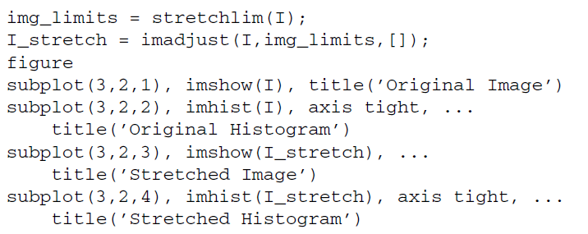
Histogram Stretching
4. Execute the following code to see histogram stretching on the pout image, which is already loaded in variable I.
Question 4
How did the histogram change after the adjustment?
Question 5
What is the purpose of using the stretchlim function?

Slide 35
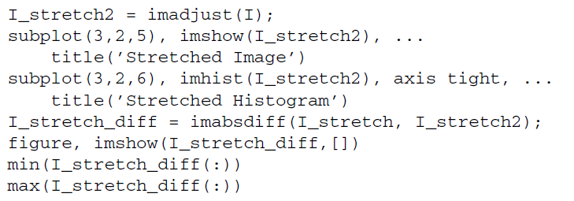
Histogram Stretching
In the previous step, we specified the low_in, high_in, low_out, and high_out parameters when calling the imadjust function when in fact the default operation is histogram stretching—meaning these parameters are not necessary to perform histogram stretching.
Notice in the next step how just calling the function and only specifying the image as its parameter will give the same results.
5. Perform histogram stretching with imadjust using default parameters and confirm that the results are identical to the ones obtained before.
Question 6
How does the difference image look?
Question 7
What is the purpose of inspecting its maximum and minimum values?

Slide 36

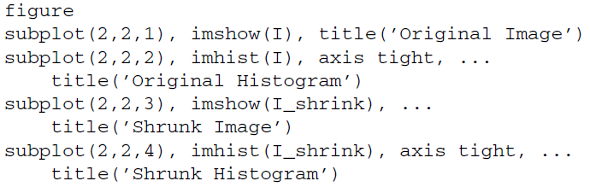
Histogram Shringking
To shrink an image histogram, we must specify the parameters explicitly.
6. Execute the following code to see the result of histogram shrinking.

Slide 37
View Transformation Function (implisitly)
When we use other techniques to adjust the histogram of an image, we have a means to view the transformation function (i.e., the histeq function will return the transformation function as an output parameter if requested).
There is no built-in technique for viewing a transformation function when performing histogram sliding, stretching, or shrinking, but we can achieve a visual representation of the transformationfunction by using the plot function.
To do so, we specify the original image as the X values and the adjusted image as the Y values.

Slide 38
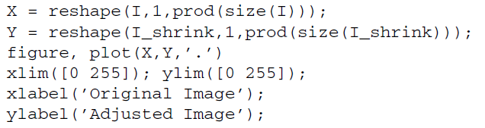
View Transformation Function (implisitly)
7. Display the transformation function for the adjustment performed in the previous step.
Question 8
What do the above first two statements in the code do?
Question 9
What does the xlabel and ylabel functions do?

Slide 39
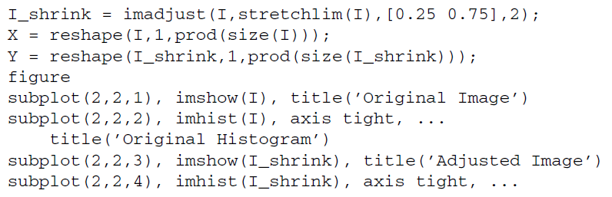
View Transformation Function (implisitly)
As noted earlier, gamma values other than 1 will specify the shape of the curve,
toward either the bright or the dark region.
8. Perform histogram shrinking with a gamma value of 2.
Question 10
The transformation function plot displays a gap from 0 to 12 (on the X axis) where there are no points. Why is this so?

Slide 40
Thanks
“HAPPY LEARNING”

